Slide 1
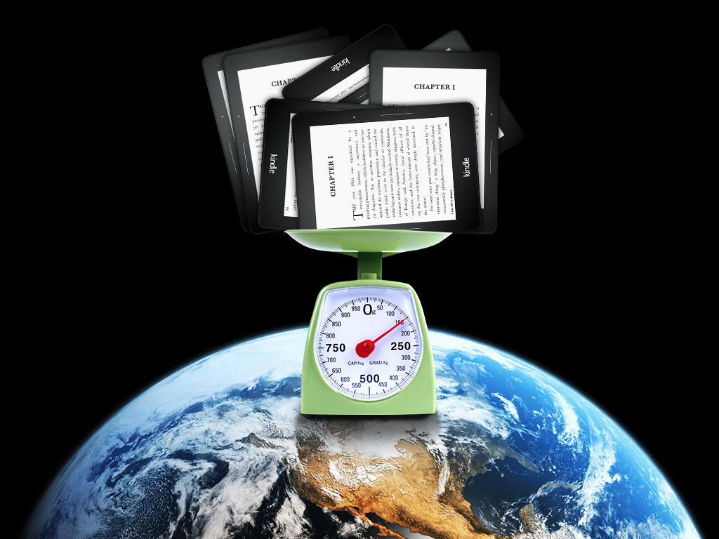
Can We Put Readers First on a Global Scale?
Digital Book 2015 Program
Richard Charkin

Slide 2
Thank you

