Slide 1
Garth Conboy
EPUB 3 Working Group Vice-chair
IDPF Board Chairman
Interactive Content:
EPUB, EDUPUB & Scriptable Components

Slide 2
EPUB 3
EPUB is the distribution and interchange format standard for digital publications and documents based on Web Standards
XHTML, HTML5, CSS, SVG, images, audio, video
Markup, Metadata, and Packaging
http://idpf.org/epub/301
Consistent Cross-platform Rendering
Two Flavors
Flowing
Fixed Layout

Slide 3
EPUB 3 Interactivity
Interactive Books or Apps?
EPUB Interactivity is Provided via JavaScript
Children’s & YA Books, Cookbooks
Sci-Fi/Fantasy, Comics/Manga/GN, Textbooks
Two flavors
Spine-level scripting
An instance of <script> included in a top-level Content Document
Container constrained scripting
An instance of <script> in a Content Document that is embedded in an <object>, <embed>, or <iframe>
Sprinkles on the side
Spine-level scripting in Fixed Layout

Slide 4
EPUB 3
Javascript Support in EPUB 3 Reading Systems
Yes
Apple/iBooks
Kobo
New Readium-based platforms
Some Web-based platforms (e.g., VitalSource)
No
Amazon/Kindle
B&N/Nook
Google Play
http://epubtest.org/compare/

Slide 5
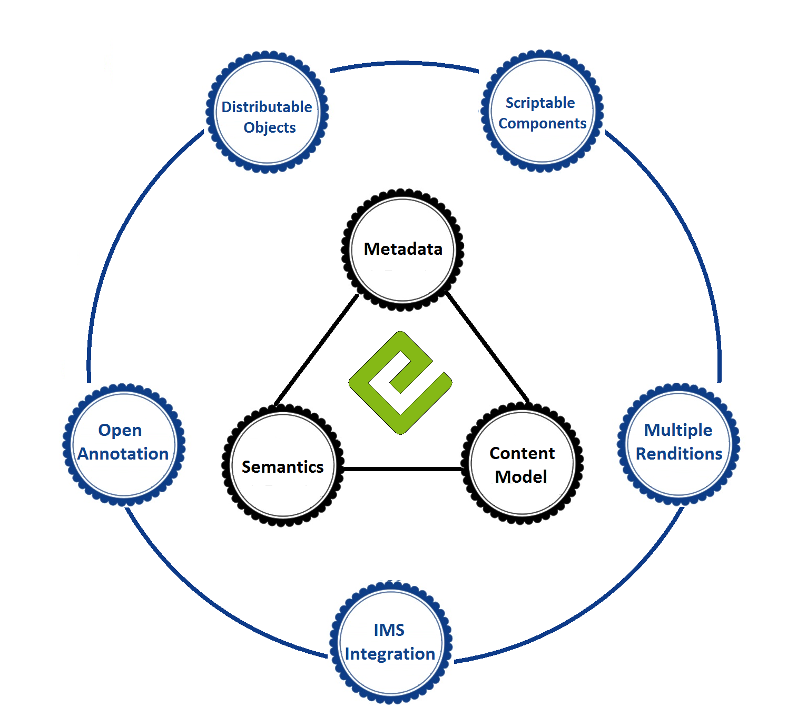
EDUPUB
Universe
Encapsulation, transportation, and integration of publication components
Cross-platform interactivity in flowing content
Student/teacher,
accessibility,
audience, role, activity, …
Extended EPUB structural semantics: asides, testing, learning objectives
EPUB 3
Shared annotation import & export; JSON & EPUB CFI
Focus on re-flowable & accessible; FL should be semantic, not image-based
Hierarchy-linked TOC, H1-H6 headings, nested sections & asides, page-list nav
The LMS Side of the World

Slide 6
EDUPUB
EDUPUB Profile of EPUB 3
Complete set of specification drafts now in review:
EDUPUB Profile: http://idpf.org/epub/profiles/edu/spec
Open Annotation in EPUB: http://idpf.org/epub/oa
Distributable Objects: http://idpf.org/epub/do
Scriptable Components Packaging and Integration: http://idpf.org/epub/sc/pkg
Scriptable Components: http://idpf.org/epub/sc/api
IMS EDUPUB Best Practices: http://www.imsglobal.org/edupub/index.html
Open issues at https://code.google.com/p/epub-revision/issues/list

Slide 7
EPUB Scriptable Components
ESC Packaging Details
ESC’s are packaged as EPUBs
No new XML vocabularies are required.
The epubcheck validation tool can be used to ensure validity of the Scriptable Components, and that all necessary resources are present.
The Package Document can be used to store Scriptable Component metadata.
Fixed-layout metadata can be used to communicate the desired aspect ratio.
Standalone debugging of Scriptable Components is possible, as the Scriptable Components can be ingested into any Reading System with scripting support (a component is simply a “page” with spine-level scripting).
Round-trip-able via Distributed Object <collection>

Slide 8
EPUB Scriptable Components
Components API
Purpose: provide interoperable mechanism for widget communication, interaction, and nesting
Augments, does not replace EPUB 3.0.1 scripting
Designed to work in RS that support spine level scripting with no effort
Architecture
All components must be in an <iframe>
All communication done with postMessage
Messaging implementation included in the spine
Enables drop-in support if spine-level scripting is supported

Slide 9
EPUB 3.1
EPUB 3.0.1 and EDUPUB are complete and near-complete
EPUB 3.1 Starting Now
“Do less rather than more”
Draft charter here
Incorporate specs since 3.0.1 (DO, ESC, region-based Navigation, …)
Consider deprecations
Synchronize with W3C (HTML5, CSS 3)
Limited additional features
Bug fixes

Slide 10
End

