Slide 1
How Can You Tell It's Working? Crucial Analytics for the Educational Publisher in Content for Mobile
Moderator:
Rob Abel, Ed. D.
(IMS Global Learning Consortium, Inc.)
François-Xavier Hussherr
Founder & CEO Gutenberg Technology
George Moore
CTO (Cengage Learning)

Slide 2
LIVE Metrics

Slide 3
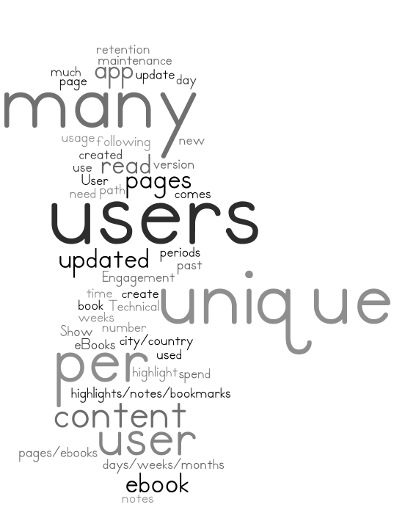
The more you know, the more you fit
How many new users
in the past following days ?
When unique users
use the most the app ?
How many users
have updated
their content ?
In which city/country
my content is used most ?
What is the second
content that my user buy ?
How many pages are read
per day per unique user ?
Which are the pages/ebooks
with the most number
of highlights/notes ?
How much time per page
a unique user spend ?
Notes:
As students work through online lessons, Knewton analyzes vast amounts of anonymized data to figure out what a student knows and how they learn best. Then Knewton recommends what to study next, helping students at any level succeed.
Students who have different needs, interests, strengths, and weaknesses can work toward goals in the perfect sequence and pace for them. Teachers use Knewton-powered real-time predictive analytics to detect gaps in knowledge and differentiate instruction.

Slide 4
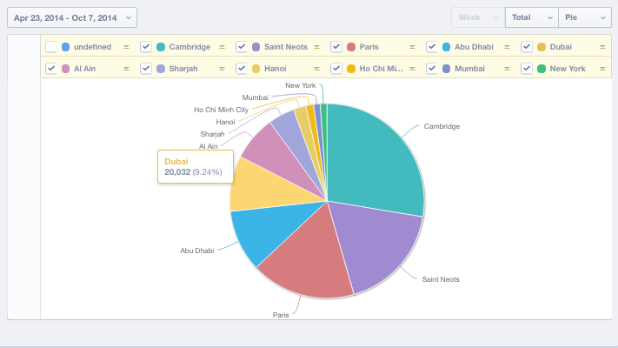
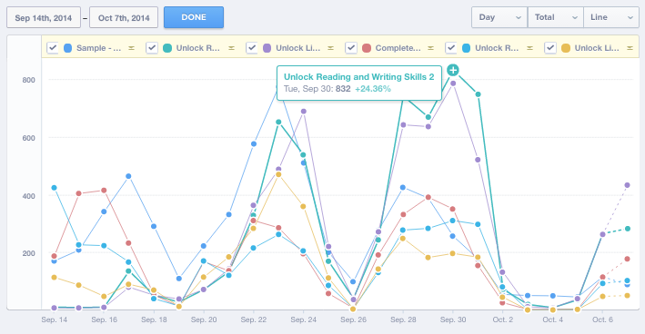
Real time dashboard
Notes:
As students work through online lessons, Knewton analyzes vast amounts of anonymized data to figure out what a student knows and how they learn best. Then Knewton recommends what to study next, helping students at any level succeed.
Students who have different needs, interests, strengths, and weaknesses can work toward goals in the perfect sequence and pace for them. Teachers use Knewton-powered real-time predictive analytics to detect gaps in knowledge and differentiate instruction.

Slide 5
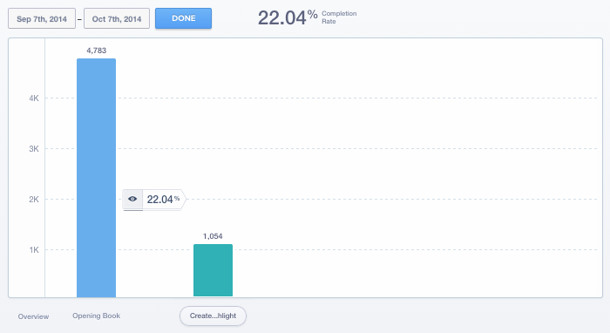
Analyse its user path
Notes:
As students work through online lessons, Knewton analyzes vast amounts of anonymized data to figure out what a student knows and how they learn best. Then Knewton recommends what to study next, helping students at any level succeed.
Students who have different needs, interests, strengths, and weaknesses can work toward goals in the perfect sequence and pace for them. Teachers use Knewton-powered real-time predictive analytics to detect gaps in knowledge and differentiate instruction.

Slide 6
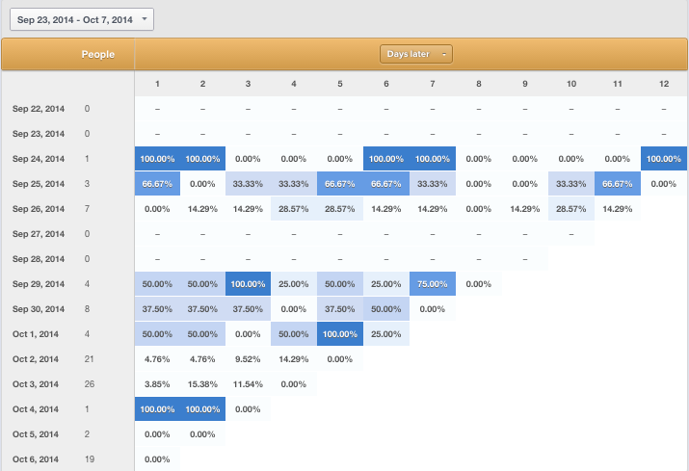
Measure customer engagement
Notes:
As students work through online lessons, Knewton analyzes vast amounts of anonymized data to figure out what a student knows and how they learn best. Then Knewton recommends what to study next, helping students at any level succeed.
Students who have different needs, interests, strengths, and weaknesses can work toward goals in the perfect sequence and pace for them. Teachers use Knewton-powered real-time predictive analytics to detect gaps in knowledge and differentiate instruction.

Slide 7
Gutenberg Technology Study

Slide 8
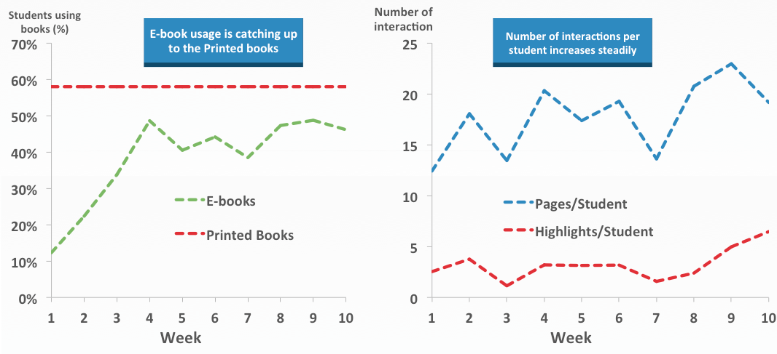
The tablet textbook acclaimed by students
1
Do students read their textbooks when available on a tablet? Gutenberg Technology conducted an extensive survey of over 4500 students, equipped with tablets, in three countries over ten consecutive weeks.
Statistical data on tablet use highlighted several key points:
1. Students refer to 18 pages a week when using a tablet.
As the following figures show, this study objectively highlights that significant student interest exists in reading digital books on a tablet:
Our study found that the digital book is quickly adopted by students and teachers in the classroom where the use of digital media averaged 44.23% for the last five weeks of the study. Actually, the use of digital media is similar to that of paper books after three weeks of use (58% on average, according to the French reports from the IGEN : printed textbook : situation and perspective - march 2012).
The number of pages students read on a tablet continued to increase from an average of 18 pages per week to a peak of 23 pages per week.

Slide 9
Interactive features help students retain knowledge
2
Students enjoyed becoming familiar with the interactive features of the
various books. For example, highlighting functions were used on average by47.7% of students. The average number of highlights increased during the
study from three highlights per student per week during the first week to six highlights per student per week during the tenth week.

Slide 10
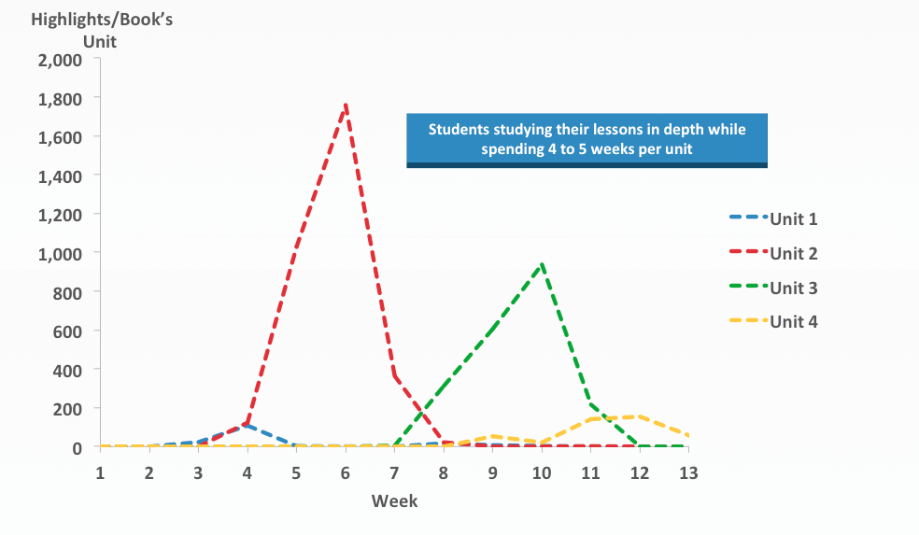
Students deepen understanding of their lessons through digital media
3
Combining the use of statistics with the content of digital books promotes a
gradual increase in the duration of study for each unit. This approach permits
a more in-depth study of previous courses for advanced students.

Slide 11
Q&A

