Slide 1
Trends in Mobile Phone Reading Randy Petway, EVP, Global Product Strategy, Publishing Technology IDPF Digital Book 2015, May 27, 2:25 – 3:05 pm
@publishingtech #mobilereading

Slide 2
Discovering a Trend: The Rise of Mobile Phone Reading
The mobile phone is rising in popularity among US readers.
Publishing Technology partnered with OnePoll to conduct a survey of 1,500 US respondents
Findings reveal mobile reading habits and roadblocks by age, gender and region, along with top consumer choices for devices, platforms and genres
User experience remains the most significant constraint
@publishingtech #mobilereading

Slide 3
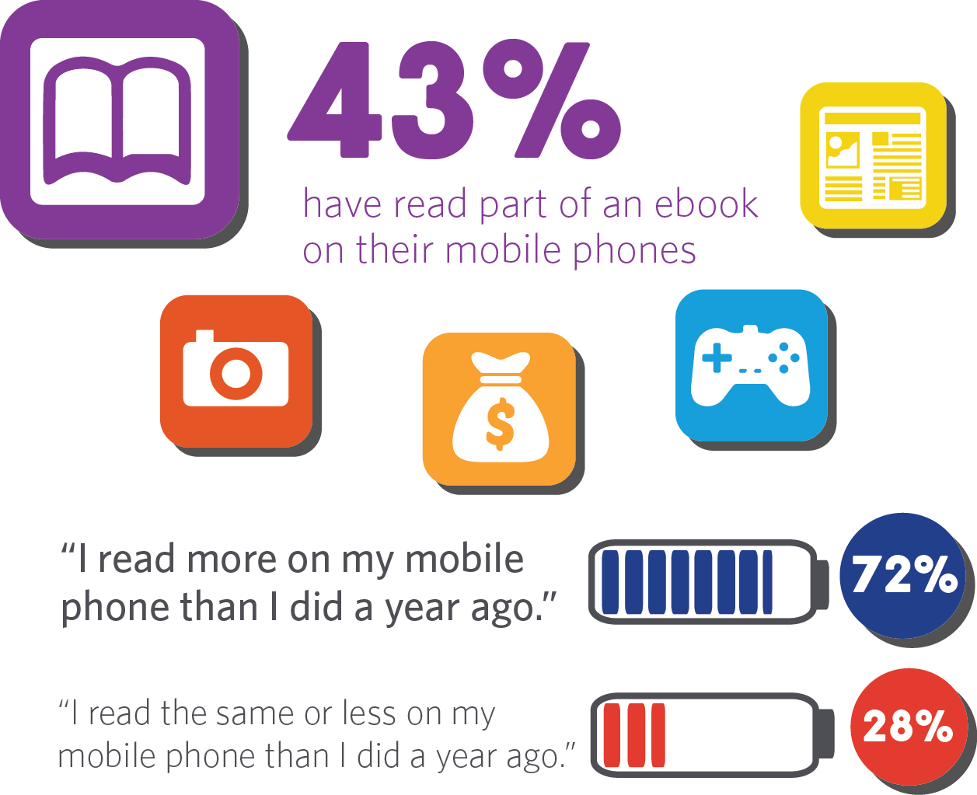
Mobile Phone Use
@publishingtech #mobilereading

Slide 4
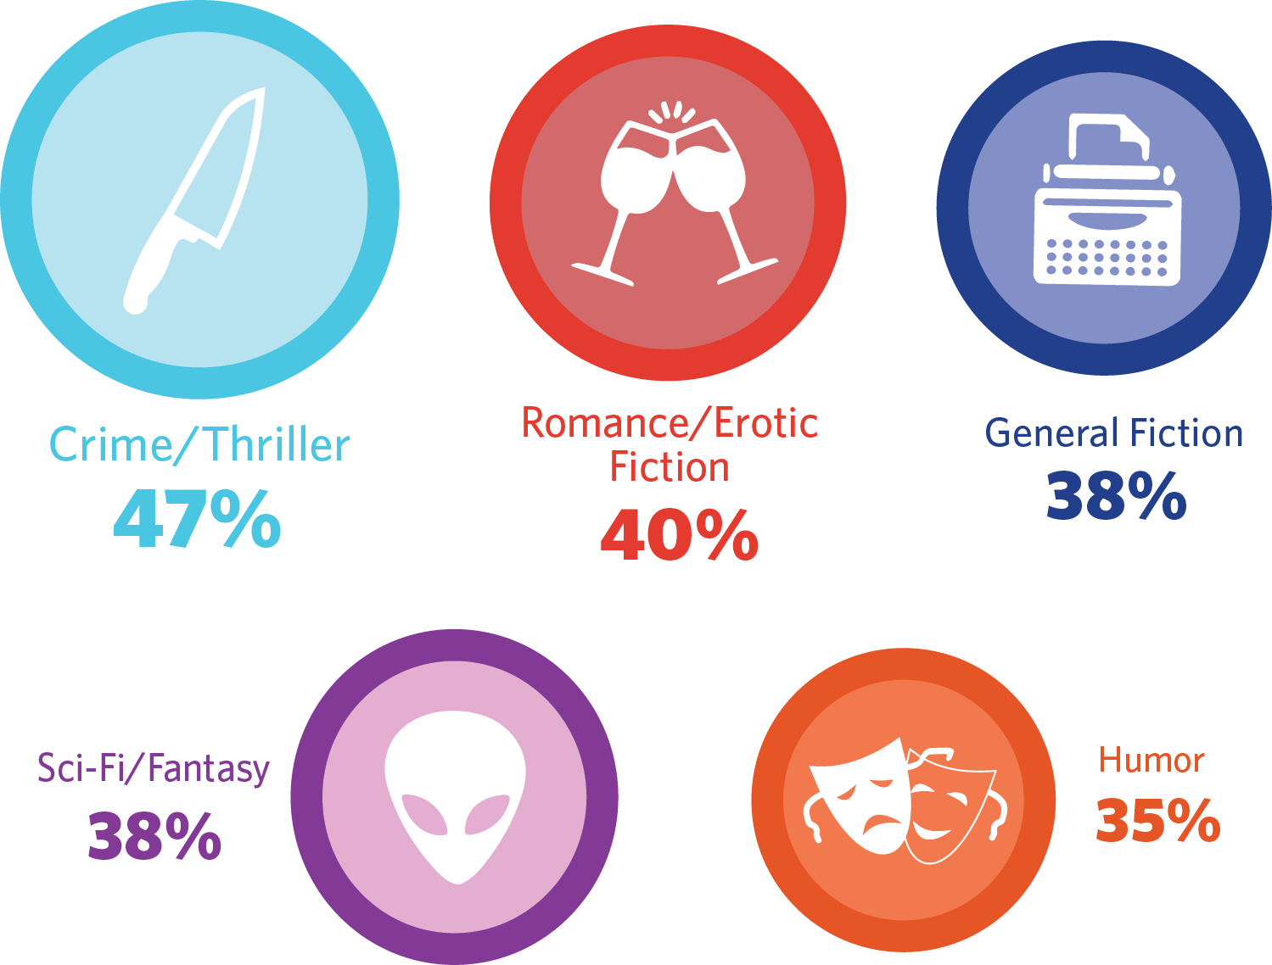
Genres Most Read on Mobile Phones
@publishingtech #mobilereading

Slide 5
Where Consumers Read on Their Mobile Phones
@publishingtech #mobilereading

Slide 6
Mobile Reader Demographics
@publishingtech #mobilereading

Slide 7
Discussion Pam Krauss, Pam Krauss Books, @ditmas5 Ralph Lazaro, Findaway, @ralphlazaro Nathan Maharaj, KOBO, @nrmaharaj

