Slide 1
Jellybooks
There is a story behind every book.
Reader Analytics - Audience Insights - Discoverability

Slide 2
Reader Analytics
Despite the digital transformation of the publishing industry,
authors & publisher
still cannot measure
actual reader engagement!
Do they actually read what they buy?

Slide 3
Observe Readers on 3rd Party Apps
Reader Analytics by Jellybooks is a platform for measuring reading engagement across 3rd party reading apps.
* Not all apps shown above have switched from ePub 2.01 to ePub 3.0 support yet or support Javascript

Slide 4
“Google Analytics for Ebooks”
Modified ebook emailed directly to users, who read on own device/3rd party app (ePub3 format)
Embedded Javascript software tracks (offline) reading
Readers click on button at end of chapter/end of ebook to upload/sync data to Jellybooks
Data Visualisation for Author/Agent/Publisher

Slide 5
Focus Group Design
In exchange for receiving a FREE ebook, the user acknowledges that the ebook comes with 3rd party tracking software.
The user MUST press SYNC inside the ebook for data to be retrieved. Otherwise data remains private.
Data is NOT anonymised before being sent to publisher. Reading can be analysed at the individual level.

Slide 6
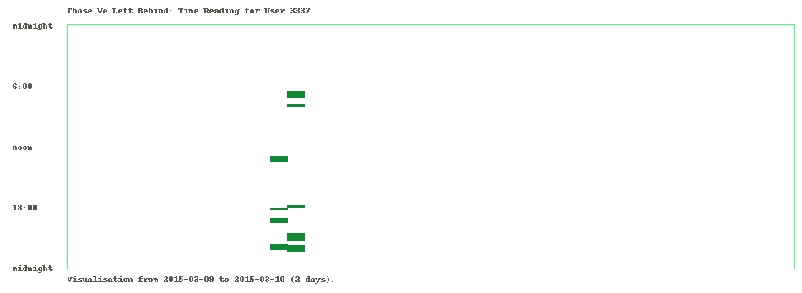
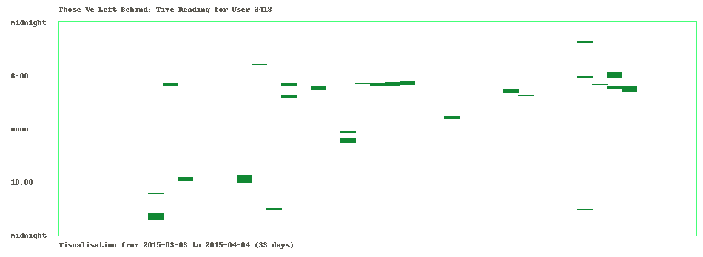
2 days
1 month

Slide 7
Audience Engagement – Completion Rate
71% Complete
24% Complete

Slide 8
Audience Engagement – Interruptions
Readers pause more often in the 2 “Monday 26th March 2007” chapters = difficult material, plus interruption in flow of time
Final suspense sequence causes users not to put book down = strong finish

Slide 9
Reading – Time of Day
Other book II
Other book III
Other book IV

Slide 10
for copy of prezo send email to vip@jellybooks.com
The End

Slide 11
ePub Modification by Jellybooks
PRHUK supplied files as regular ePub3 files
Candy.js embedded into file via Jellyfactory
Sync buttons automatically inserted via Jellywrapper
Modification is visible to user at bottom of cover via “candy stripe”

