Slide 1
eTextbooks and the Open Web Platform
A Report from the Oct 2013 EDUPUB Workshop
Samir Kakar
Chief Technology Officer, Aptara

Slide 2
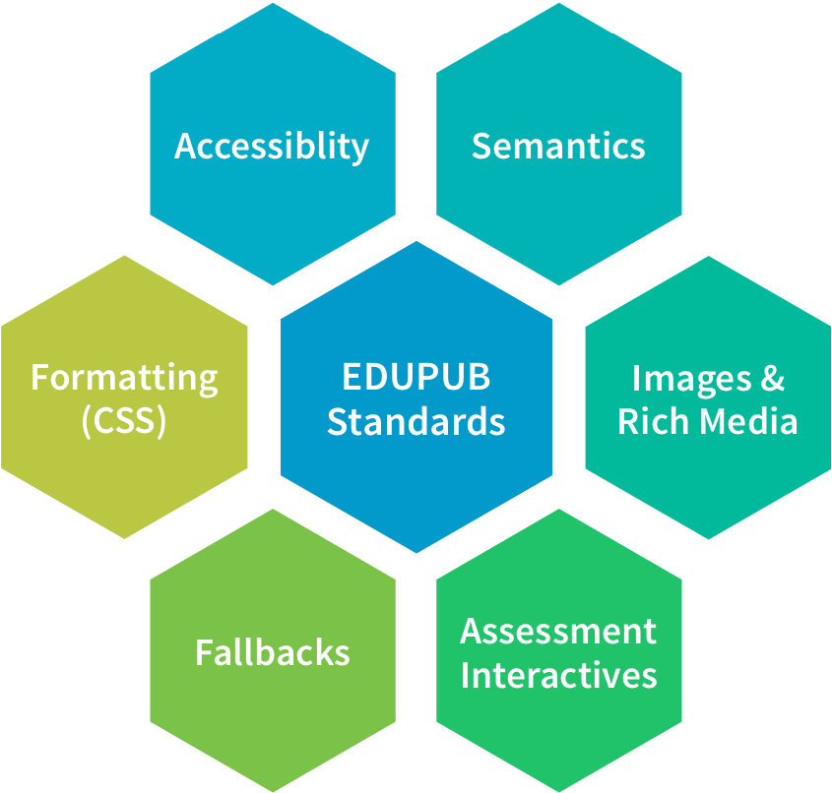
EDUPUB Profile
The EDUPUB Profile is a standard way to deliver educational content in an EPUB 3 format.
Pearson Learning is releasing the EDUPUB Profile as a baseline for building an open source standard.
http://idpf.org/sites/default/files/file_attach/PearsonEDUPUB%20Ecosystem%20Final.pdf
Notes:
HTML5 core of the EPUB 3 standard, which is one of its strengths, did not address the specific complexities and semantic nuances required to express educational content. While EPUB 3 includes key features such as support for MathML, rich media, interactivity, and accessibility features, the omissions were fundamental to education publishers.
One great example has to do with metadata. Textbooks require many metadata attributes that are more specific than what is provided for in the baseline EPUB 3 specification. EPUB 3 is intended for use with all types of publications and documents, so was designed with the ability for different communities adopting EPUB 3 to add more detailed metadata constructs meeting their needs
one of our primary drivers in adopting XHTML5/EPUB 3 was that the mark-up is so close to the output. This minimizes the complexity and risk of errors associated with heavy transformation of XML source content to a styled output format.

Slide 3
The EDUPUB Profile: The Deliverables
Baseline Specification
Detailed Content Model
EDUPUB Reference Implementation
EDUPUB Pattern Library
Notes:
Dave Stroup’s Summary slide:
By standardizing educational semantics and reducing the number of variable formats for similar content – publishers, vendors, and content distributors can devote more of their resources to improving content, authoring & assembly tools, services, and end user experience – and less on creating redundant output formats that provide no competitive advantage – truly a win-win for all involved!

Slide 4
EDUPUB Workshop Foundation Principles
Adopt a content as “code” paradigm replacing the content as “data” model
Embrace and evolve “Output-ready” standards replace “intermediary” standards
Create content that is semantically structured and relevant for education
Realize that learning metadata standards are as important as structural standards
Create only content that is accessible and logically separates content and style
http://idpf.org/sites/default/files/file_attach/EDUPUB%20Keynote%20Annotated.pdf
Notes:
The results of the workshop should be opinions that are pervasive, not just any one company’s opinion.
Content is ubiquitous. It is no longer about structured knowledge created for a specific function. Content is unbound.
Code drives structure and function.

Slide 5
EDUPUB Workshop Foundation Principles, cont’d.
All content standards must include display/player capabilities (e.g. HTML5 players)
Minimize any form of content transformation needed for display on many devices
Support the creation of a structured authoring and assembly tool ecosystem
All content must be capable of emitting meaningful usage and learning data
Accept that there is NO competitive advantage in proprietary content models
http://idpf.org/sites/default/files/file_attach/EDUPUB%20Keynote%20Annotated.pdf
Notes:
Complexity Cancels Ubiquity.
Keep It Simple.
Education Technology is very good if not overcomplicated.
We want things to be less expensive.
We want kids to learn more
We content to be immersive

Slide 6
EDUPUB Workshop Themes
#1: Educational Interoperability Landscape
#2: Rich and Interactive Content
#3: Accessibility
#4: Production Workflows
Notes:
Theme 1: Educational Interoperability Landscape
Theme Moderator - Rob Abel, Ed.D, CEO IMS
In the modern e-learning environment, several standards and protocols need to interoperate to create the context in which institutions, teachers, and students can interoperably utilize the environment with maximum efficiency. Which are the standards available today for describing and connecting the various components of an e-learning environment, and how are they evolving? How does an ebook "connect" with the surrounding context to become integrated with a range of learning environments? How will e-books be shared, launched and enabled for analytics across a wide variety of use cases? These and many other related questions will be answered in this session, where experts in the field will discuss and demonstrate the current state of affairs, and identify areas where further development may be needed to enable full interoperability.
Theme 2: Rich and Interactive Content
Theme moderator- Bill McCoy, Exec Director IDPF
With the ability to use the full power of the Open Web Platform in ebooks, virtually endless possibilities arise in terms of creating new and enriched reading experiences. How are these features best deployed pedagogically in the education realm, now and in the future? This session will discuss challenges and opportunities that publishers face today with regards to the production and integration of rich and interactive content.
Theme 3: Accessibility
Theme Moderator- Markus Gylling, CTO IDPF
Which are the current and upcoming challenges and opportunities that publishers and solution providers face when it comes to accessible educational e-publishing? What is needed in terms of metadata standards to describe publication and client accessibility properties? How are technologies and best practices evolving for making STEM and other rich interactive content accessible? Are there really any significant differences between web and long-form e-publication accessibility? In this session, ongoing efforts for establishing a naturally accessible e-learning environment will be reviewed, and experts in the field will point out the most critical areas for further work.
Theme 4: Production Workflows
Theme Moderator -Paul Belfanti
There’s a lot of uncertainty within the educational publishing community today over whether standards can be supported broadly and consistently enough across the industry to produce rich, interactive content in a cost-effective manner and deliver that content to multiple platforms that support these rich experiences. Publishers hesitate to make the investment in developing interactive content because eReaders and distribution platforms don’t support advanced features or EPUB 3. Device makers and eReader developers hesitate to invest in platforms that support advanced features when they don’t see publishers producing content using standards like EPUB 3, etc.. In this session we will present real examples of production workflows that demonstrate the efficiency and versatility of standards-based content development, assembly, delivery, and presentation, along with existing tools that address issues like authoring,

Slide 7
EDUPUB Widgets
A widget is “a mini application with limited functionality that can be placed on a book page and executed automatically or by the end user, e.g. a gallery, clock, stock ticker”
MetroDigi donated specific widget code to the IDPF to be considered as an EPUB enhancement proposal. Specific widgets donated include:
Video | Audio | Popup
Gallery or Image sequence | Multiple Choice or True/False Quiz | Text Resizer
Scrolling Sidebar | Flashcards | Tabs and Accordions
Image comparison | Image scroller | Drag and Drop Quiz
Charts | Graphs
http://idpf.org/sites/default/files/file_attach/metrodigi_edupub_v2-released.pdf

Slide 8
EDUPUB Collaborative Media Package
A Collaborative Media Package is a specification designed to enable publishers to build an ecosystem around a group of existing and new EPUB assets
VersaPub donated a Collaborative Media Package (CMP) Specification Profile to the IDPF to be considered as an enhancement to the EPUB specification
CMP Specification Profile is freely available at http://pubbl.org/
http://idpf.org/sites/default/files/file_attach/VP%20%20EduPub%20CMP%20Presentation%2010292013.pdf
Notes:
Helps build an ecosystem around ePub assets
Updateable with new Epub content
Crowdsourcing new ePub content for existing epub content
Crowdsourcing new asseccibility enabled epub content for existing epub
Provide dynamic Epub content based on assessment results and usage

Slide 9
EDUPUB Collaborative Media Package, cont’d.
Collaborative Media Packages enable:
Users who want to update personal EPUB collections with their own content
Easy creation of
3rd Party EPUB content assets
Creating annotations which can be shared across EPUB files
Creating assessment driven and dynamic EPUB content that adapts to a student’s reading and learning style
http://idpf.org/sites/default/files/file_attach/VP%20%20EduPub%20CMP%20Presentation%2010292013.pdf
Notes:
Source new contnet directly for exisiting Epub assets
User sepcific contextually releavant content or recommendations
Maintain persisten dynaic history of remixed Epub assets (annotations, videos new chapter etc)
Meet, collaborate and share with others
Use cases for collaborative media packaging include:
Allowing users to update their own EPUB collections with their own content.
Easy creation of 3rd party EPUB content assets into a collection

Slide 10
Key Priorities Moving Forward
Project | Initial Contacts | Organizations
Educational Profile for EPUB 3 | Paul Belfanti Markus Gylling | IDPF
QTI Integration (including asynchronous communication) | Colin Smythe Wilbert Kraan | IMS, IDPF
LRMI + Accessibility Integration | Madeleine Rothberg Matt Garrish | IDPF, IMS
Content Linkage to LTI | Colin Smythe Markus Gylling | IMS, IDPF
Outcomes and Analytics Services (including asynchronous comm.) | Colin Smythe | IMS
EPUB Widget Specification and Library | Markus Gylling Ron Severdia Gerardo Capiel Colin Smythe | IDPF, IMS https://github.com/idpf/

Slide 11
Key Priorities Moving Forward, cont’d.
Project | Initial Contacts | Organizations
EPUB3 “Discrete Entity” Metadata | Bill Kasdorf | IDPF, LRMI
Reference implementation of fully accessible Reading System + EDUPUB features (including MathML!) | Ric Wright Daniel Weck | Readium Foundation
UAAG 2.0 Review: RS Perspective | Markus Gylling Suzanne Taylor | W3C DPUB IG
Establish forum for assessment/STEM support in ARIA | Mark Hakkinen Markus Gylling Rich Schwerdtfeger | W3C DPUB IG, IDPF, IMS
Open Annotations in ARIA | Markus Gylling | IDPF
http://idpf.org/sites/default/files/file_attach/Edupub2013Summary.pdf

Slide 12
EDUPUB 100 Day Challenge
Action priorities into work streams with real plans
Create new communities to drill down and evolve the specs
Coordinate the work with academic publishing timeframes
Build uniﬁed requirement documents for player vendors
Support the creation of new HTML5 and WebGL interactives

Slide 13
EDUPUB 100 Day Challenge, cont’d.
Expand the accessibility discussions to interactive content
Move forward with a shared vision of Learning Architecture
Transform “publishing = web” into “EDUCATION = web”
FUEL a collaborative ecosystem for digital education content
Ship real immersive EDUPUB products in 2014!!!

Slide 14
EDUPUB2 Workshop on Digital Publishing for Education
Invitation only per application: http://www.imsglobal.org/edupub/edupubparticipate.cfm
Workshop goal “To bring together major players of the global K-20 education segment… to help advance the effective adoption and use of e-textbooks and other digital learning materials by improving interoperability and baseline capabilities via broad adoption of enabling technical standards.”
Workshop focus “To bring together market-leading organizations that will be key to the implementation and widespread adoption of EDUPUB.”
http://www.imsglobal.org/edupub/index.html

Slide 15
EDUPUB2 Workshop Agenda Topics
Launching EDUPUB players/applications from learning platforms
Integration of interoperable assessment content in EDUPUB
Educational resource and accessibility metadata in EDUPUB
Outcomes and analytics data and services from EDUPUB
EPUB widget specification and library
http://www.imsglobal.org/edupub/edupubagendatopics.html

Slide 16
EDUPUB2 Workshop Agenda Topics, cont’d.
EPUB content structure/discrete entity metadata
Readium reference implementation of accessible reading system
UAAG 2.0 (User Agent Accessibility Guidelines) review
Assessment/STEM support in W3C ARIA
Open annotations for EPUB
http://www.imsglobal.org/edupub/edupubagendatopics.html

Slide 17
Thank you!
Questions?
Samir Kakar
Chief Technology Officer
samir.kakar@aptaracorp.com

